Slide 1
Course Name: Fundamentals of Computing
Course Code: CS16
Credits: 2:0:0
UNIT 1
Term: Odd Semester 2021
M.S. Ramaiah Institute of Technology
(Autonomous Institute, Affiliated to VTU)
Department of Computer Science and Engineering
Faculty:
Mrs.Darshana A Naik
Mrs.Shilpa H
Mrs Sunitha R S
DEPARTMENT OF COMPUTER SCIENCE AND ENGINEERING

Slide 2
UNIT 1
Overview and Problem Solving with C: Computing Systems: Hardware and Software, An Engineering problem –Solving Methodology: Compute the straight-line distance between two points in a plane, Freezing Temperature of Seawater. Overview of C: Importance of C, Basic Structure of C Programs, UNIX System. Constants, Variables and Data types: Character Set, C-Tokens, Keywords and Identifies, Constants, Variables, Data Types, Defining Symbolic Constants. Managing Input and Output Operations: Reading a Character, Writing a Character, Formatted Output.
DEPARTMENT OF COMPUTER SCIENCE AND ENGINEERING

Slide 3
UNIT 2
Operators and Expressions: Arithmetic Operators, Relational Operators, Logical Operators, Assignment Operators, Increment and Decrement Operators, Conditional Operators, Arithmetic Expressions, Evaluation of Expressions, Precedence of Arithmetic Operators, Type Conversions in Expressions, Operator Precedence and Associatively. Control Structures in C: Algorithm Development, Decision Making and Branching: Simple IF statement, IF..Else Statement, Nesting of IF...Else, The Else IF Ladder, The Switch Statements. The GOTO Statement. Decision Making and Looping: Introduction, The While Statement, The DO statement, The FOR statement, Jumps in Loops.
DEPARTMENT OF COMPUTER SCIENCE AND ENGINEERING

Slide 4
UNIT 3
Arrays and Matrices: One-Dimensional Array, Two-Dimensional Arrays (Declaration and Compile Time and Run Time Initialization). Sorting Algorithms, Search Algorithms, Character Arrays and Strings: Introduction, Declaring and Initializing String Variables, Reading Strings from Terminal, Writing Strings to Screen, Arithmetic Operations on Characters, String Handling Functions, Other String Functions.
DEPARTMENT OF COMPUTER SCIENCE AND ENGINEERING

Slide 5
UNIT 4
User Defined Functions: Introduction, Need for User-Defined Functions, Elements of User-Defined Functions, Definition of Functions, Return Values and Their Types, Function Calls, Categories of Functions, Recursion. The scope, visibility and lifetime of variables: Automatic variables, Static Variables, Register Variables, and External Variables. Structures: Defining a Structure, Declaring Structure Variables, Accessing Structure Members, Structure Initialization, Copying and Comparing Structure variables, Arrays of Structures, Arrays within Structures.
DEPARTMENT OF COMPUTER SCIENCE AND ENGINEERING

Slide 6
UNIT 5
Pointers: Introduction, Understanding Pointers, Accessing the Address of a Variable, Declaring Pointer Variables, Initialization of Pointer Variables, Accessing a variable through its pointer, Pointer Expressions, Pointers and Arrays, Pointers and Character Strings, Pointers as Function Arguments.
File:Introduction to files, Using files in C: Declaring a File Pointer Variables, Opening a File, Closing a File Using fclose ().Read data from files: fscanf(),fgest(),fgetc() and fread().Writing Data to Files: fprintf(),fputs(),fputc() and fwrite().
DEPARTMENT OF COMPUTER SCIENCE AND ENGINEERING

Slide 7
Books
Delores M. Etter -Engineering Problem Solving with C, Third Edition.
E. Balagurusamy - Programming in ANSI C, TMH, 6th Edition, 2012.
Reema Tharaje - Programming in C, 1st Edition, Oxford University press 2012.
DEPARTMENT OF COMPUTER SCIENCE AND ENGINEERING

Slide 8
CIE TEST(50 Marks)
SEE Exam(100 Marks)
1. Two Test -30 Marks Each
Average of two test will be taken into account.
2.Two Quiz Test-20 Marks Each
No Average will be taken
Dates for both the components will be announced.
DEPARTMENT OF COMPUTER SCIENCE AND ENGINEERING

Slide 9
Computing Systems
Computer: a machine that is designed to perform operations (set of instructtions called program) to achieve a specific task (e.g., 3+4)
Hardware: computer equipment (e.g., keyboard,
mouse, terminal, hard disk, printer)
Software: programs that describe the steps we want the computer to perform.
DEPARTMENT OF COMPUTER SCIENCE AND ENGINEERING

Slide 10
Internal Organization of a computer
Internal
Memory
External
Memory
Processor
Input
Output
ALU
CPU
CPU - Central processing unit
ALU - Arithmetic and logic unit
ROM - Read only memory
RAM - Random access memory
DEPARTMENT OF COMPUTER SCIENCE AND ENGINEERING

Slide 11
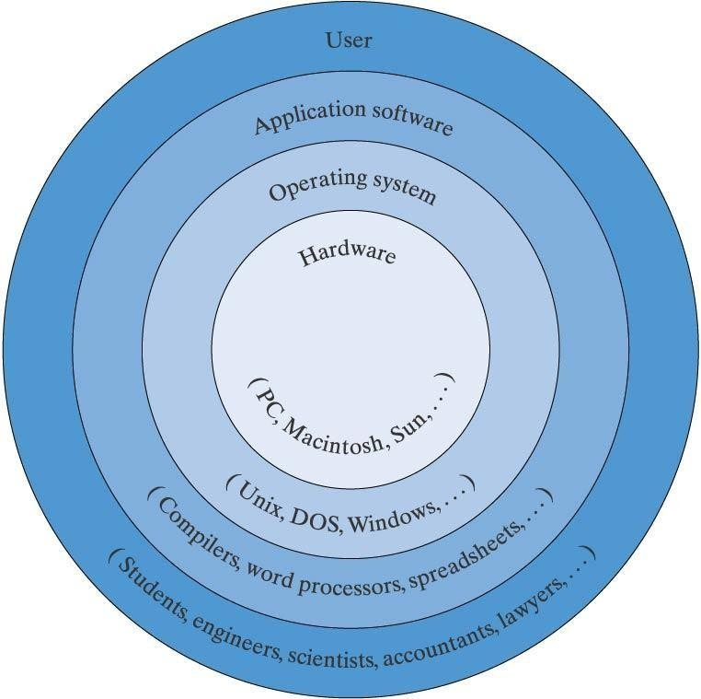
Computer Software
Operating System - Provides an interface with the user
  unix, windows, linux, ...
Software Tools
  word processors (MicrosoftWord, WordPerfect, ...)
  spreadsheet programs (Excel, Lotus1-2-3, ...)
  mathematical computation tools (MATLAB, Mathematica, ...)
Computer Languages
  machine language
  assembly language
  binary language
  high level languages (C, C++, Ada, Fortran, Basic, java)
WE WILL STUDY C
PROGRAMMING LANGUAGE
  General purpose, machine-independent language
  Developed at Bell Labs in 1972 by Dennis Ritchie
  American National Standards Institute(ANSI) approved ANSI C standard in 1989
DEPARTMENT OF COMPUTER SCIENCE AND ENGINEERING

Slide 12
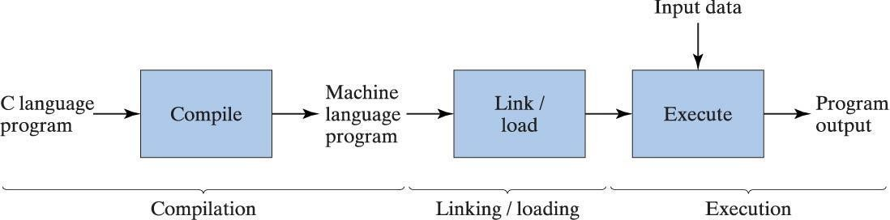
Executing a Computer Program
Compiler
  Converts source program to object program
Linker
  Converts object program to executable program
DEPARTMENT OF COMPUTER SCIENCE AND ENGINEERING

Slide 13
Some Key Terms
Source Program
  printable/Readable Program file
Object Program
  nonprintable machine readable file
Executable Program
  nonprintable executable code
Syntax errors
  reported by the compiler
Linker errors
  reported by the linker
Execution/Run-time errors
  reported by the operating system
DEPARTMENT OF COMPUTER SCIENCE AND ENGINEERING

Slide 14
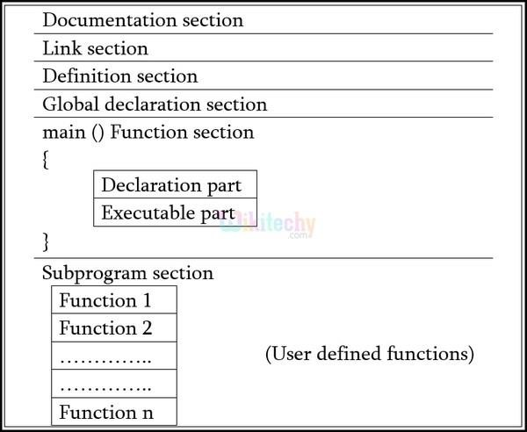
Program Structure
DEPARTMENT OF COMPUTER SCIENCE AND ENGINEERING

Slide 15
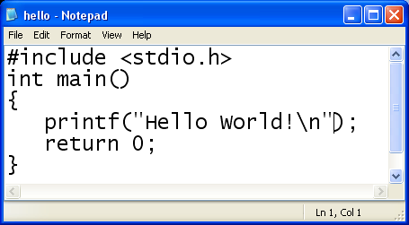
Program Structure
DEPARTMENT OF COMPUTER SCIENCE AND ENGINEERING
26

Slide 16
Questions
A CPU consists of ALU, Memory and Control Unit. ---
Linking and loading is the step that prepares the
object program for execution. ---
An algorithm describes the problem solution step by step, while a computer program solves the problem in one step. ---
A computer program is the implementation of an algorithm. ---
A microprocessor is a process that is very small. ---
DEPARTMENT OF COMPUTER SCIENCE AND ENGINEERING

Slide 17
Questions
A CPU consists of ALU, Memory and Control Unit. ---
True
Linking and loading is the step that prepares the object program for execution. --- True
An algorithm describes the problem solution step by step, while a computer program solves the problem in one step. --- False
A computer program is the implementation of an
algorithm. --- True
A microprocessor is a process that is very small. ---
False
DEPARTMENT OF COMPUTER SCIENCE AND ENGINEERING

Slide 18
Questions
Spreadsheets are useful to manipulate objects graphically. ---
Computer aided design is used only to design microcomputers. ---
The fastest computer is microprocessor. ---
Spaces cannot be present within a variable name. ---
Variables can be declared anywhere in a C program. -
--
DEPARTMENT OF COMPUTER SCIENCE AND ENGINEERING

Slide 19
Questions
Spreadsheets are useful to manipulate objects graphically. --- False
Computer aided design is used only to design microcomputers. --- False
The fastest computer is microprocessor. --- False
Spaces cannot be present within a variable name. ---
True
Variables can be declared anywhere in a C program. -
-- False
DEPARTMENT OF COMPUTER SCIENCE AND ENGINEERING

Slide 20
General Form
The main function contains two types of commands: declarations and statements
Declarations and statements are required to end with a semicolon (;)
Preprocessor directives do not end with a semicolon
To exit the program, use a
return 0; statement
preprocessing directives
int main(void)
{
declarations statements
}
DEPARTMENT OF COMPUTER SCIENCE AND ENGINEERING
28

Slide 21
Importance of C
It is a robust language whose rich set of built-in functions and operators can be used to write any complex program.
C Compiler combines the capabilities of an assembly language with the features of a high-level language and therefore it is well suited for writing both system software and business packages.
C is highly portable. This means that C programs written for one computer can be run on another with little no modification.
C language is well suited for structured programming, thus requiring the user to think of a problem in terms of function modules or blocks.
C program is basically a collection of functions that are supported by the C library.
DEPARTMENT OF COMPUTER SCIENCE AND ENGINEERING

Slide 22
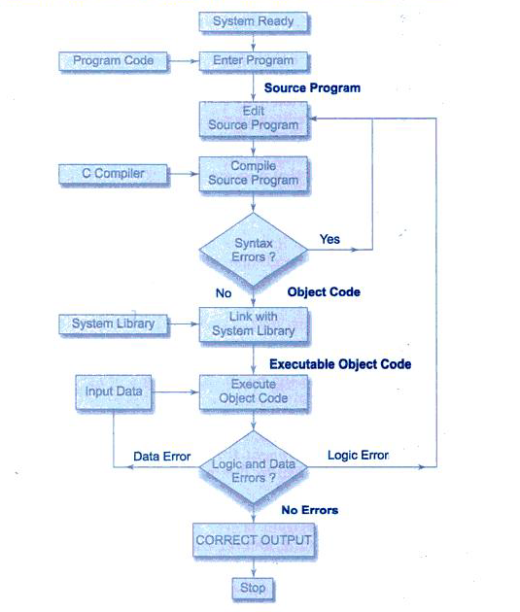
Process of Compiling and executing C program
DEPARTMENT OF COMPUTER SCIENCE AND ENGINEERING

Slide 23
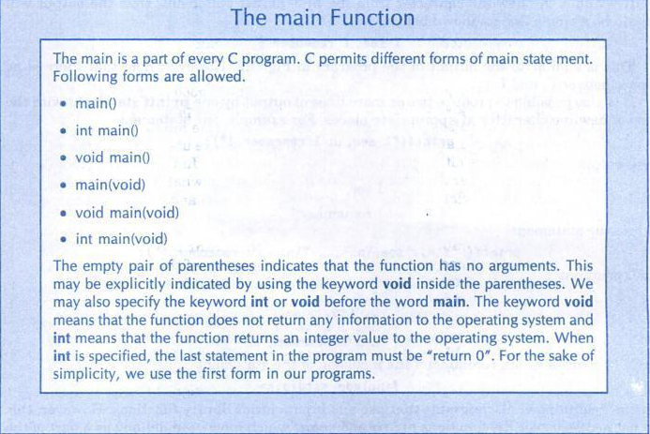

DEPARTMENT OF COMPUTER SCIENCE AND ENGINEERING

Slide 24
Another Program
/***************************************************/
/*
/*
Program chapter1 */
This program computes the sum of two numbers */
#include <stdio.h> int main(void)
{
/* Declare and initialize variables. */
double number1 = 473.91, number2 = 45.7, sum;
/* Calculate sum. */
sum = number1 + number2;
/* Print the sum. */
printf(“The sum is %f \n”, sum);
return 0; /* Exit program. */
}
/****************************************************/
DEPARTMENT OF COMPUTER SCIENCE AND ENGINEERING
2
9

Slide 25

/* */
Comments Preprocessor, standard C library
every C program must have main function, this one takes no parameters and it returns int value
{ → begin
Variable declarations, initial values (if any)
Statements
must end with ;
indentation
/* Program chapter1_1
/* This program computes the
/* distance between two points.
*/
*/
*/
#include <stdio.h> #include <math.h>
int main(void)
{
/* Declare and initialize variables. */
double x1=1, y1=5, x2=4, y2=7, side_1, side_2, distance;
/* Compute sides of a right triangle. */
side_1 = x2 - x1; side_2 = y2 - y1;
distance=sqrt(side_1*side_1 + side_2*side_2);
indentation
indentation
/* Print distance. */
printf("The distance between the two " "points is %f \n", distance);
return 0
} → end of function
return 0; /* Exit program. */
}
DEPARTMENT OF COMPUTER SCIENCE AND ENGINEERING
27
/* */

Slide 26
Constants and Variables
What is a variable in math? f(x) = x²+x+4
In C,
  A variable is a memory location that holds a value
  An identifier or variable name is used to reference a memory location.
DEPARTMENT OF COMPUTER SCIENCE AND ENGINEERING
30

Slide 27
Memory
double x1=1,x2=7,distance;
name address
Memory - content
… 11
12
13
14
1 = 00000001
7 = 00000111
? = 01001101
How many memory cells
does your computer have?
Say it says 2Gbyte memory?
x1
x2
1K=10³
1M=10⁶
1G=10⁹
or 2¹⁰ = 1024
or 2²⁰ = 1024²
or 2³⁰ = 1024³
distance 15
16
…
DEPARTMENT OF COMPUTER SCIENCE AND ENGINEERING
31

Slide 28
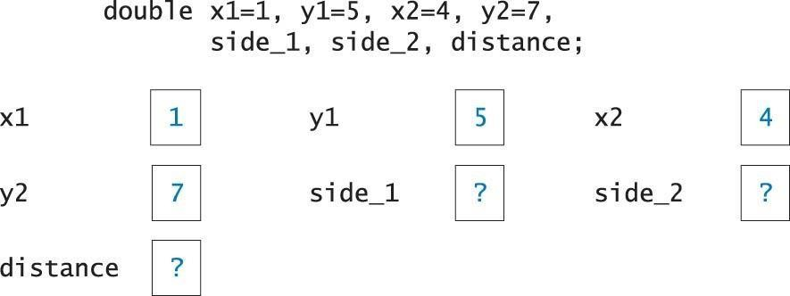
Memory Snapshot
Name | Addr | Content
x1 |  | 1
y1 |  | 5
x2 |  | 4
y2 |  | 7
side_1 |  | ?
side_2 |  | ?
distance |  | ?
DEPARTMENT OF COMPUTER SCIENCE AND ENGINEERING

Slide 29
Rules for selecting a valid identifier (variable name)
Must begin with an alphabetic character or underscore (e.g., abcABC_)
May contain only letters, digits and underscore (no special characters ^%@)
Case sensitive (AbC, aBc are different)
Cannot use C keywords as identifiers (e.g., if, case, while)
DEPARTMENT OF COMPUTER SCIENCE AND ENGINEERING

Slide 30
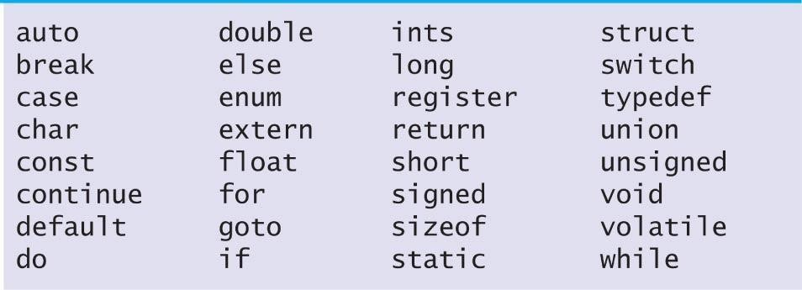
Are the following valid identifiers?
distance
1x
x_1
rate%
x_sum
switch
initial_time
DisTaNce
X&Y
DEPARTMENT OF COMPUTER SCIENCE AND ENGINEERING

Slide 31
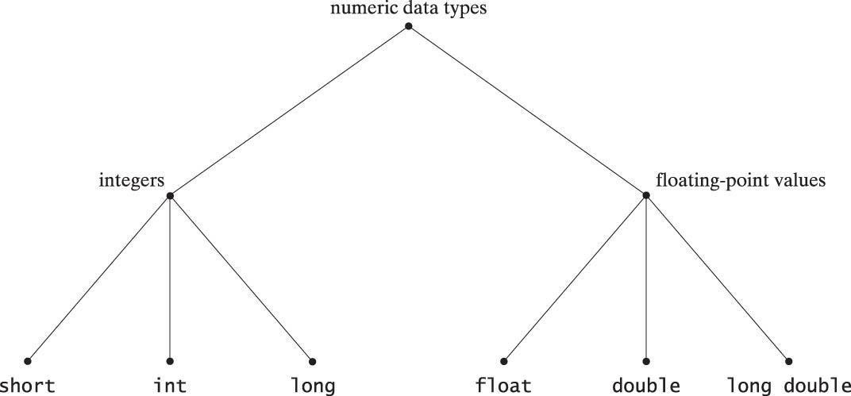
C Numeric Data Types
DEPARTMENT OF COMPUTER SCIENCE AND ENGINEERING

Slide 32
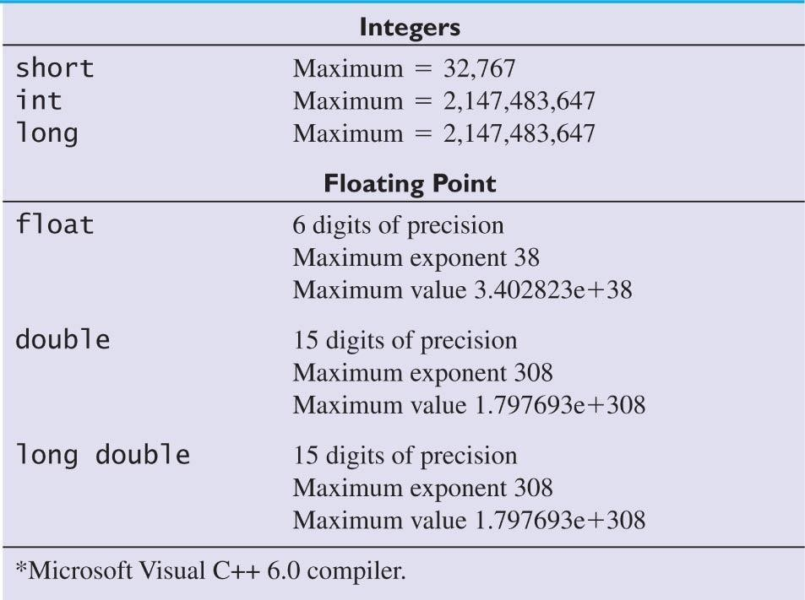
Example Data-Type Limits
DEPARTMENT OF COMPUTER SCIENCE AND ENGINEERING

Slide 33
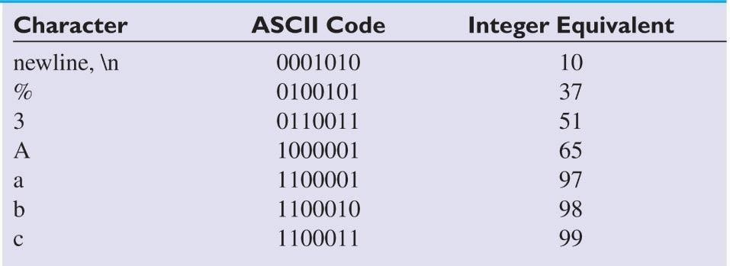
C Character Data Type: char
char result =‘Y’;
In memory, everything is stored as binary value, which can be interpreted as char or integer. Examples of ASCII Codes
DEPARTMENT OF COMPUTER SCIENCE AND ENGINEERING

Slide 34
Memory
name address
0
My_letter 1
My_number 2
3
4
5
6
…
Memory - content
How to represent ‘a’ ?
char My_letter=‘a’;
int My_number = 97
Always we have 1’s and 0’s in the memory. It depends on how you look at it?
For example, 01100001 is 97 if you look at it as int, or
‘a’ if you look at it as char
‘3’ is not the same as 3 How to represent 2.5?
‘a’= 01100001
97 = 01100001
? = 01001101
DEPARTMENT OF COMPUTER SCIENCE AND ENGINEERING
38

Slide 35
Constants
A constant is a specific value that we use in our programs. For example
3.14, 97, ‘a’, or “hello”
01100001
01100001
?
?
2.0
In your program,
int a = 97;
char b =‘a’;
double area, r=2.0;
double circumference;
area = 3.14 * r*r;
circumference = 2 * 3.14 * r;
a
b
area
circumf
erence
r
DEPARTMENT OF COMPUTER SCIENCE AND ENGINEERING

Slide 36
Symbolic Constants
What if you want to use a better estimate of π?
For example, you want 3.141593 instead of 3.14.
You need to replace all by hand
Better solution, define π as a symbolic constant, e.g.
#define PI 3.141593
…
area = PI * r * r;
circumference = 2 * PI * r;
Defined with a preprocessor directive
Compiler replaces each occurrence of the directive identifier with the constant value in all statements that follow the directive
DEPARTMENT OF COMPUTER SCIENCE AND ENGINEERING

Slide 37
Assignment Statements
Used to assign a value to a variable
General Form:
identifier = expression;
/* ‘=‘ means assign expression to identifier */
Example 1
double sum = 0;
Example 2 int x; x=5;
Example 3
char ch;
ch = ‘a’;
0
5
‘a’
sum x
ch
DEPARTMENT OF COMPUTER SCIENCE AND ENGINEERING

Slide 38
Assignment examples (cont’d)
Example 3
int x, y, z;
x = y = 0; right to left!
x y z
0
0
Z = 1+1;
2
Example 4
y=z;
y=5;
DEPARTMENT OF COMPUTER SCIENCE AND ENGINEERING

Slide 39
Assignment examples with different types
a b c
int a, b=5; double c=2.3;
… a=c; c=b;
? 2
5
2.3 5.0
long double, double, float, long integer, integer, short integer, char
→ Data may be lost. Be careful!
← No data loss
DEPARTMENT OF COMPUTER SCIENCE AND ENGINEERING
44

Slide 40
Exercise: swap
First Attempt x=y; y=x;
x
y
3
5
x
y
5
5
x
y
5
5
Before
After x=y
After y=x
DEPARTMENT OF COMPUTER SCIENCE AND ENGINEERING
45

Slide 41
Exercise: swap
Solution
temp= x;
x=y; y=temp;
x y temp
x y temp
x y temp
x y temp
5
3
3
3
5
?
3
5
3
5
5
3
Before
after temp=x
after x=y
after y = temp
Will the following solution work, too?
temp= y; y=x; x=temp;
DEPARTMENT OF COMPUTER SCIENCE AND ENGINEERING
46

Slide 42
Standard Input and Output
Output:
Input:
printf
scanf
Remember the program computing the distance between two points!
/* Declare and initialize variables. */
double x1=1, y1=5, x2=4, y2=7, side_1, side_2, distance;
How can we compute distance for different points?
It would be better to get new points from user, right? For this we will use scanf
To use these functions, we need to use
#include <stdio.h>
DEPARTMENT OF COMPUTER SCIENCE AND ENGINEERING

Slide 43
Standard Output
printf Function
  prints information to the screen
  requires two arguments
    control string
      Contains text, conversion specifiers or both
    Identifier to be printed
Access
Specifier
Example
Control String
double angle = 45.5;
printf(“Angle = %.2f degrees \n”, angle);
Output:
Angle = 45.50 degrees
Identifier
DEPARTMENT OF COMPUTER SCIENCE AND ENGINEERING

Slide 44
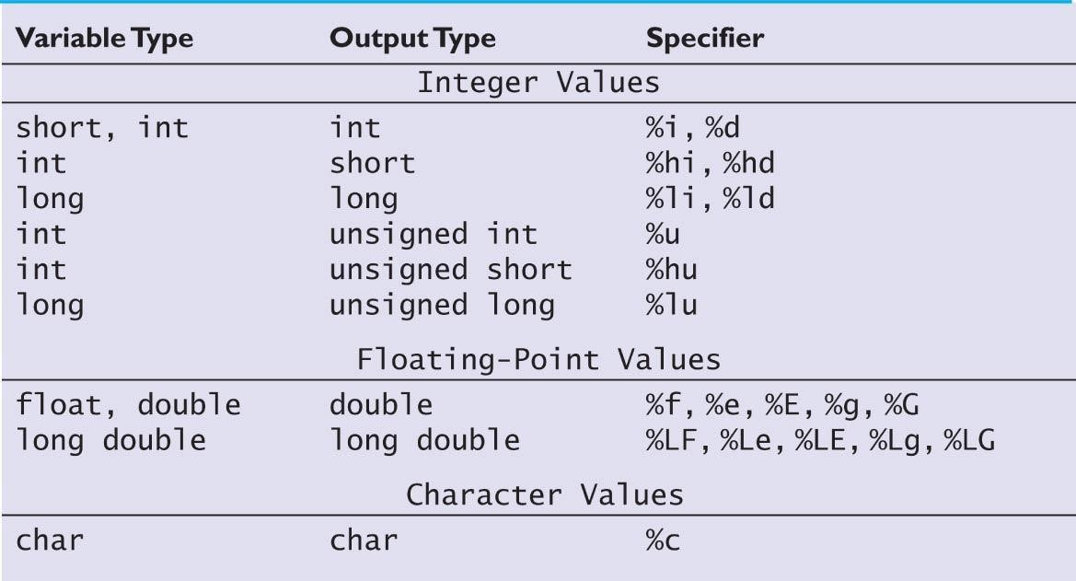
Conversion Specifiers for Output Statements
Frequently Used
DEPARTMENT OF COMPUTER SCIENCE AND ENGINEERING

Slide 45
Standard Output
Output of 157.8926
Specifier | Value Printed
%f | 157.892600
%6.2f | 157.89
%7.3f | 157.893
%7.4f | 157.8926
%7.5f | 157.89260
%e | 1.578926e+02
%.3E | 1.579E+02
DEPARTMENT OF COMPUTER SCIENCE AND ENGINEERING

Slide 46
Exercise
int sum = 65;
double average = 12.368; char ch = ‘b’;
Show the output line (or lines) generated by the following statements.
printf("Sum = %5i; Average = %7.1f \n", sum, average);
printf("Sum = %4i \n Average = %8.4f \n", sum, average);
printf("Sum and Average \n\n %d %.1f \n", sum, average);
printf("Character is %c; Sum | is | %c \n", ch, sum);
printf("Character is %i; Sum | is | %i \n", ch, sum);
DEPARTMENT OF COMPUTER SCIENCE AND ENGINEERING

Slide 47
Exercise (cont’d)
Solution
Sum =
Sum =
65; Average =
65
12.4
Average = 12.3680 Sum and Average
65 12.4
Character is b; Sum is A Character is 98; Sum is 65
DEPARTMENT OF COMPUTER SCIENCE AND ENGINEERING

Slide 48
Standard Input
scanf Function
  inputs values from the keyboard
  required arguments
    control string
    memory locations that correspond to the specifiers in the
control string
Example:
int distance; char unit_length;
scanf("%lf %c", &distance, &unit_length);
 It is very important to use a specifier that is appropriate for the data
type of the variable
DEPARTMENT OF COMPUTER SCIENCE AND ENGINEERING

Slide 49
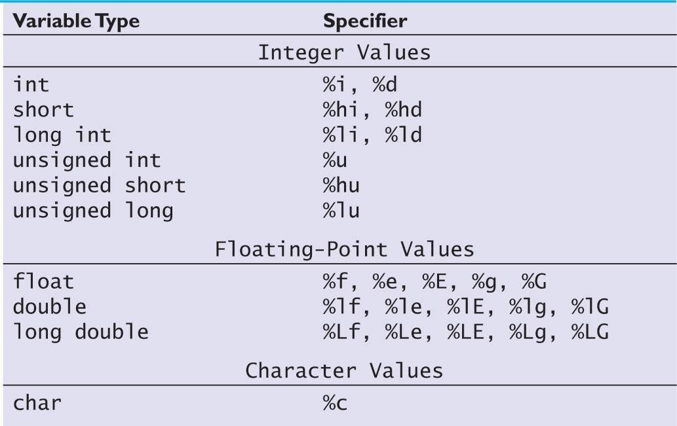
Conversion Specifiers for Input Statements
Frequently Used
DEPARTMENT OF COMPUTER SCIENCE AND ENGINEERING

Slide 50
Exercise
float f; int i;
scanf(“%f %d“, &f, &i);
What will be the values stored in f and i after scanf statement if following values are entered
12.5 1
12 45
12 23.2
12.1
12
1
10
DEPARTMENT OF COMPUTER SCIENCE AND ENGINEERING

Slide 51
Good practice
You don’t need to have a printf before scanf, but it is good to let user know what to enter:
printf(“Enter x y : ”);
scanf(“%d %d”, &x, &y);
Otherwise, user will not know what to do!
What will happen if you forget & before the variable name?
DEPARTMENT OF COMPUTER SCIENCE AND ENGINEERING

Slide 52
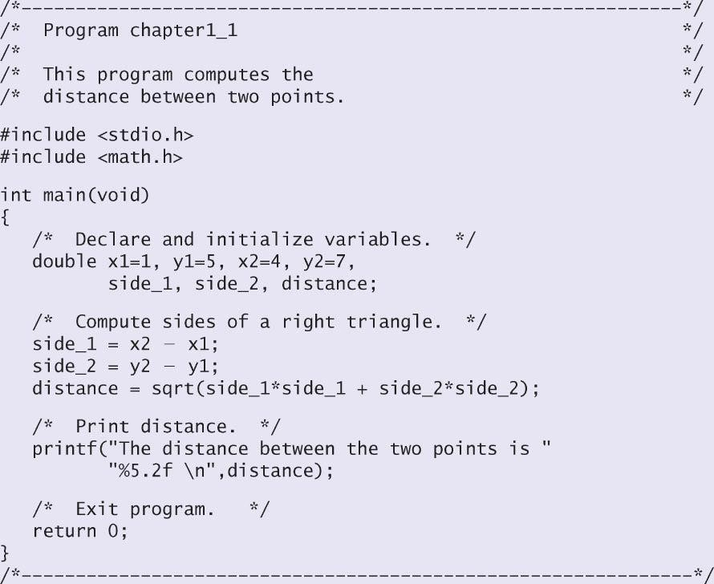
Exercise: How to input two points without re-compiling the program
printf(“enter x1 y1: “); scanf(“%lf %lf“, &x1, &y1); printf(“enter x2 y2: “); scanf(“%lf %lf“, &x2, &y2);
DEPARTMENT OF COMPUTER SCIENCE AND ENGINEERING

Slide 53
Programming exercise
Write a program that asks user to enter values for the double variables (a, b, c, d) in the following formula. It then computes the result (res) and prints it with three digits after .
a + c c +b c − d a − b a +c
res = ^{a + b} +
DEPARTMENT OF COMPUTER SCIENCE AND ENGINEERING

Slide 54
Math Functions
#include <math.h>
fabs(x) Absolute value of x.
sqrt( x) Square root of x, where x>=0.
pow(x,y)
Exponentiation, x^{y}. Errors occur if
x=0 and y<=0, or if x<0 and y is not an integer.
Rounds x to the nearest integer toward ∞ (infinity). Example, ceil( 2 . 01 ) is equal to 3.
Rounds x to the nearest integer toward -∞ (negative infinity). Example, f loor( 2 . 01 ) is equal to 2.
Computes the value of e^{x}.
Returns ln x, the natural logarithm of x to the base e.
Errors occur if x<=0.
Returns log10x, logarithm of x to the base 10.
Errors occur if x<=0.
c e i l ( x )
f loor( x)
exp(x)
log( x)
log10(x)
DEPARTMENT OF COMPUTER SCIENCE AND ENGINEERING

Slide 55
Trigonometric Functions
si n( x)
cos( x)
tan(x) asin(x)
Computes the sine of x, where x is in radians. Computes the cosine of x, where x is in radians Computes the tangent of x, where x is in radians. Computes the arcsine or inverse sine of x,
where x must be in the range [-1, 1].
Returns an angle in radians in the range [-π/2,π/2].
acos(x) Computes the arccosine or inverse cosine of x,
where x must be in the range [-1, 1].
Returns an angle in radians in the range [0, π].
atan(x) Computes the arctangent or inverse tangent of x. The
Returns an angle in radians in the range [-π/2,π/2].
atan2(y,x) Computes the arctangent or inverse tangent of the value y/x. Returns an angle in radians in the range [-π, π].
DEPARTMENT OF COMPUTER SCIENCE AND ENGINEERING

Slide 56
Reading a Character
The simplest of all input/output operations is reading a character from the ‘standard input’ unit. Reading a single character can be done by using function getchar.
Syntax:
Variable_name=getchar();
Eg:
char name;
name=getchar();
DEPARTMENT OF COMPUTER SCIENCE AND ENGINEERING

Slide 57
Writing a character
Like getchar, there is an analogous function putchar for writing characters one at a time to the terminal.
Syntax:
putchar(variable_name);
where variable name is a type char variable containing a character.
Eg: answer=‘Y’;
putchar(answer);
DEPARTMENT OF COMPUTER SCIENCE AND ENGINEERING

Slide 58
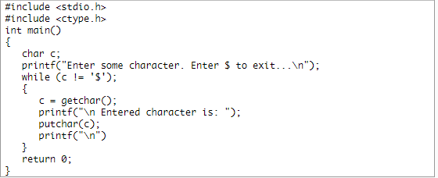
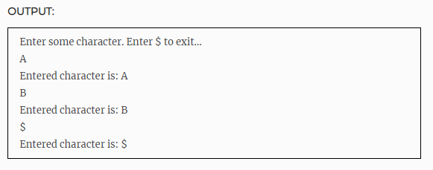
C program to show the user of getchar and putchar function .
DEPARTMENT OF COMPUTER SCIENCE AND ENGINEERING

Slide 59
Parameters or Arguments of a function
A function may contain no argument or contain one
or more arguments
If more than one argument, list the arguments in the correct order
Be careful about the meaning of an argument. For example, sin(x) assumes that x is given in radians, so to compute the sin of 60 degree, you need to first conver 60 degree into radian then call sin function:
#define PI 3.141593
theta = 60;
theta_rad = theata * PI / 180;
b = sin(theta_rad); /* is not the same as sin(theta); */
DEPARTMENT OF COMPUTER SCIENCE AND ENGINEERING

Slide 60
Exercise
Write an expression to compute velocity using the following equation
Assume that the variables are declared
velocity =
vo² + 2a(x − xo)
velocity = sqrt(vo*vo+2*a*(x-xo));
velocity = sqrt(pow(vo,2)+2*a*(x-xo));
DEPARTMENT OF COMPUTER SCIENCE AND ENGINEERING

Slide 61
Character Functions
#include <ctype.h>
putchar(‘a’);
C= getchar();
toupper(ch)
If ch is a lowercase letter, this function returns the corresponding uppercase letter; otherwise, it returns ch Returns a nonzero value if ch is a decimal digit; otherwise, it returns a zero.
Returns a nonzero value if ch is a lowercase letter; otherwise, it returns a zero.
Returns a nonzero value if ch is an uppercase letter; otherwise, it returns a zero.
Returns a nonzero value if ch is an uppercase letter or a lowercase letter; otherwise, it returns a zero.
Returns a nonzero value if ch is an alphabetic character or a numeric digit; otherwise, it returns a zero.
isdigit(ch)
islower(ch)
isupper(ch)
isalpha(ch)
DEPARTMENT OF COMPUTER SCIENCE AND ENGINEERING

Slide 62
Exercise
What is the output of the following program
#include <stdio.h> #include <ctype.h>
int main(void)
{
char ch1='a', ch2; char ch3='X', ch4;
char ch5='8';
ch2 = toupper(ch1); printf("%c %c \n",ch1,ch2); ch4 = tolower(ch3); printf("%c %c \n",ch3,ch4);
printf("%d\n",isdigit(ch5)); printf("%d\n",islower(ch1)); printf("%d\n",isalpha(ch5));
return(0);
}
DEPARTMENT OF COMPUTER SCIENCE AND ENGINEERING

Slide 63
Exercise Output
What is the output of the following program
#include <stdio.h> #include <ctype.h>
int main(void)
{
char ch1='a', ch2; char ch3='X', ch4;
char ch5='8';
ch2 = toupper(ch1);
printf("%c %c \n",ch1,ch2);
ch4 = tolower(ch3);
printf("%c %c \n",ch3,ch4);
printf("%d\n",isdigit(ch5)); printf("%d\n",islower(ch1)); printf("%d\n",isalpha(ch5));
return(0);
}
a A
X x
2048
512
0
DEPARTMENT OF COMPUTER SCIENCE AND ENGINEERING

Slide 64
PROBLEM SOLVING
Very Important
DEPARTMENT OF COMPUTER SCIENCE AND ENGINEERING

Slide 65
Problem Solving Methodology (must read)
State the problem clearly
Describe the input/output information
Work the problem by hand, give example
Develop a solution (Algorithm Development)
and Convert it to a program (C program)
Test the solution with a variety of data
DEPARTMENT OF COMPUTER SCIENCE AND ENGINEERING

Slide 66

Example 1
(x1,y1)
(x2, y2)
1. Problem statement
Compute the straight line
distance between two points in a plane
2. Input/output description
Point 1 (x1, y1)
Point 2 (x2, y2)
Distance between two points (distance)
DEPARTMENT OF COMPUTER SCIENCE AND ENGINEERING

Slide 67
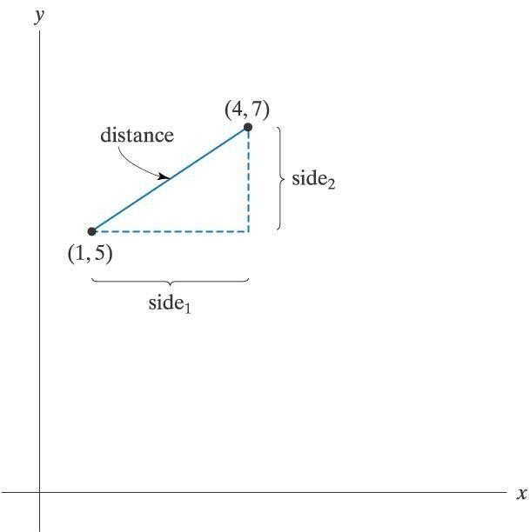
Example 1 (cont’d)
3. Hand example
side1 = 4 - 1 = 3
side2 = 7 - 5 = 2
distance = side1² +side2²
distance =
distance =
distance =
side1² +side2²
3² + 2²
13 = 3.61
DEPARTMENT OF COMPUTER SCIENCE AND ENGINEERING

Slide 68
Example 1 (cont’d)
4. Algorithm development and coding
a. Generalize the hand solution and list/outline the necessary operations step-by-step
Give specific values for point1 (x1, y1) and point2
(x2, y2)
Compute side1=x2-x1 and side2=y2-y1
3) Compute
distance = side1² +side2²
4) Print distance
DEPARTMENT OF COMPUTER SCIENCE AND ENGINEERING

Slide 69
Example 1 (cont’d)
DEPARTMENT OF COMPUTER SCIENCE AND ENGINEERING

Slide 70
Example 1 (cont’d)
5. Testing
After compiling your program, run it and see if it gives the correct result.
Your program should print out
The distance between two points is 3.61
If not, what will you do?
DEPARTMENT OF COMPUTER SCIENCE AND ENGINEERING

Slide 71
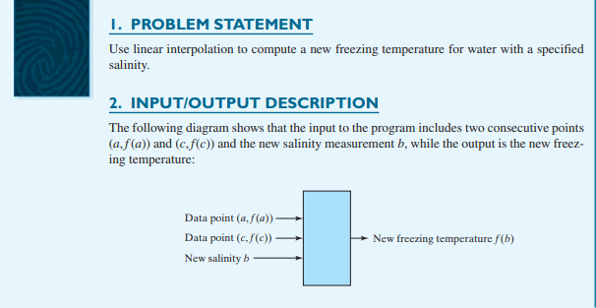
Problem Solving Methodology
DEPARTMENT OF COMPUTER SCIENCE AND ENGINEERING

Slide 72
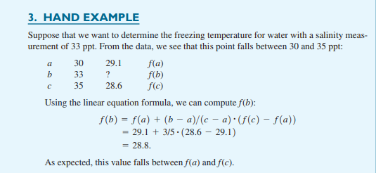
DEPARTMENT OF COMPUTER SCIENCE AND ENGINEERING

Slide 73
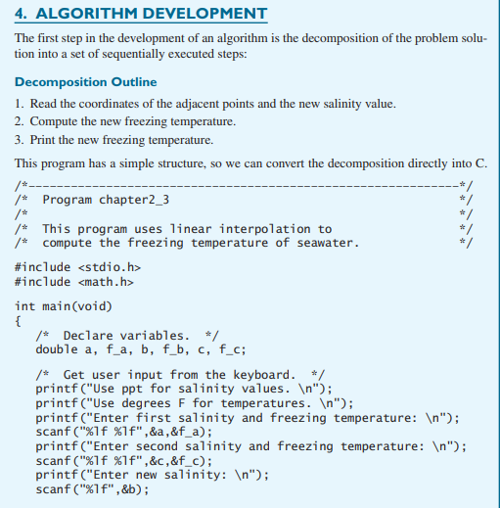
DEPARTMENT OF COMPUTER SCIENCE AND ENGINEERING

Slide 74
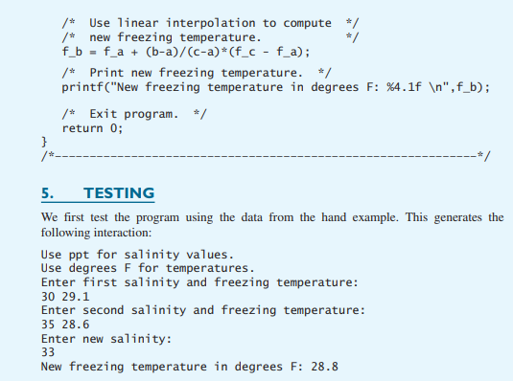
DEPARTMENT OF COMPUTER SCIENCE AND ENGINEERING

Slide 75
Simple examples to develop solutions
DEPARTMENT OF COMPUTER SCIENCE AND ENGINEERING

Slide 76
Compute the area of a triangle
State problem
I/O
Hand example
Develop solution
and Coding
Testing
x=3 cm
y=4 cm
area area = ½ * 3 *4 = 6 cm²
Get values of x and y
Compute area = ½*x*y
Print area
x
y
DEPARTMENT OF COMPUTER SCIENCE AND ENGINEERING

Slide 77
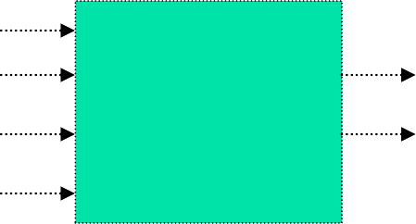
Given two complex numbers z1=a1+b1*i and z2=a2+b2*i, find z3= z1+z2
a1 b1 a2 b2
State problem
I/O
Hand example
Develop solution
and Coding
Testing
a3 b3
Get a1 b1 a2 b2
Compute a3 = a1 + a2
Compute b3 = b1 + b2
Print z3 = a3 + b3 * i
DEPARTMENT OF COMPUTER SCIENCE AND ENGINEERING

Slide 78
Given the number of seconds, find number of hours, minutes and seconds
State problem
I/O
Hand example
Develop solution
and Coding
Testing
3675 seconds can be written as
1 hour 1 min 15 sec
1. Get total_sec
2.H = total_sec / 3600 (integer division)
3. M = (total_sec – (H*3600)) / 60
M = (total_sec mod 3600) / 60
4. S = total_sec – (H*3600) – (M*60)
5. Print H hour, M min, S sec
total_sec
DEPARTMENT OF COMPUTER SCIENCE AND ENGINEERING

Slide 79
If you want this course to be easy, you must learn how to act like a computer ☺
Develop necessary step-by-step instructions to
perform the following real-life tasks like a computer
  Driving a car
  Following a direction to find an address
  Cook something
  Search a word in a dictionary
  Make a phone call
Now, its your turn to think of a problem and give STEP-BY-STEP instructions…
For the same problem, we may have different and yet correct solutions. So, …
DEPARTMENT OF COMPUTER SCIENCE AND ENGINEERING

Slide 80
Summary
Computing systems need a specific plan to design a solution for a problem.
The steps to engineering problem solving methodology are:
  Problem statement.
  Describe the input and output.
  Work the solution by hand with simple set of data.
  Design a solution and convert it into a program.
  Test the solution.
Internal organization of a computer.
Linking and loading process.
DEPARTMENT OF COMPUTER SCIENCE AND ENGINEERING

Slide 81
Thank you
DEPARTMENT OF COMPUTER SCIENCE AND ENGINEERING

